Slide 1
Runtime Monitoring
Instructor: Michael Greenbaum

Slide 2
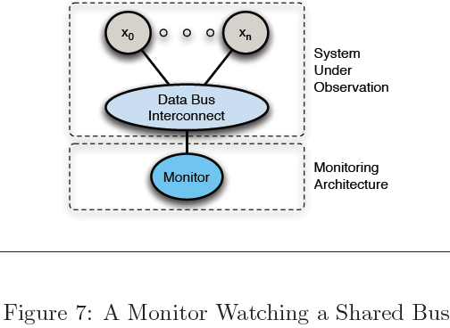
6.4.1 Bus-Monitor Architecture
BusMoP [77,70] adapts this very architecture to verify bus protocols. In the case of BusMoP, the monitor is implemented in an FPGA that is interposed between the peripheral hardware and the bus allowing it to sniff all activities on the bus. Bhargavan et al. similarly monitor activity over the wire to capture TCP packets [13, 14].
Notes:
Monitoring Distributed Real-Time Systems:
A Survey and Future Directions†
Alwyn Goodloe

Slide 3
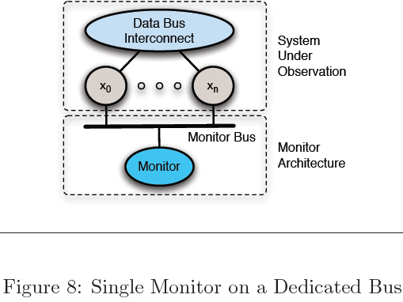
6.4.2 Single Process-Monitor Architecture
Each process in the SUO is attached to the data bus as well as a single monitor process via the dedicated monitor bus.

Slide 4
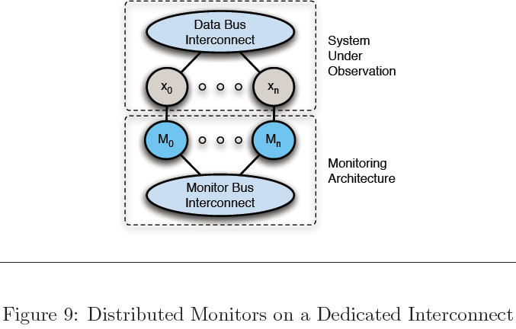
6.4.3 Distributed Process-Monitor Architecture
Distributed monitors M0, M1, . . ., Mn corresponding to each process x0, x1, . . ., xn in the SUO. Monitor Mi may be implemented on the same hardware as process xi, or it could be in its own fault-containment unit
Since multiple monitors are distributed, it can tolerate one or more monitors’ failure
Monitor Mi can serve as a guardian to its corresponding process xi to prevent babbling idiot failure.

